Slide 1
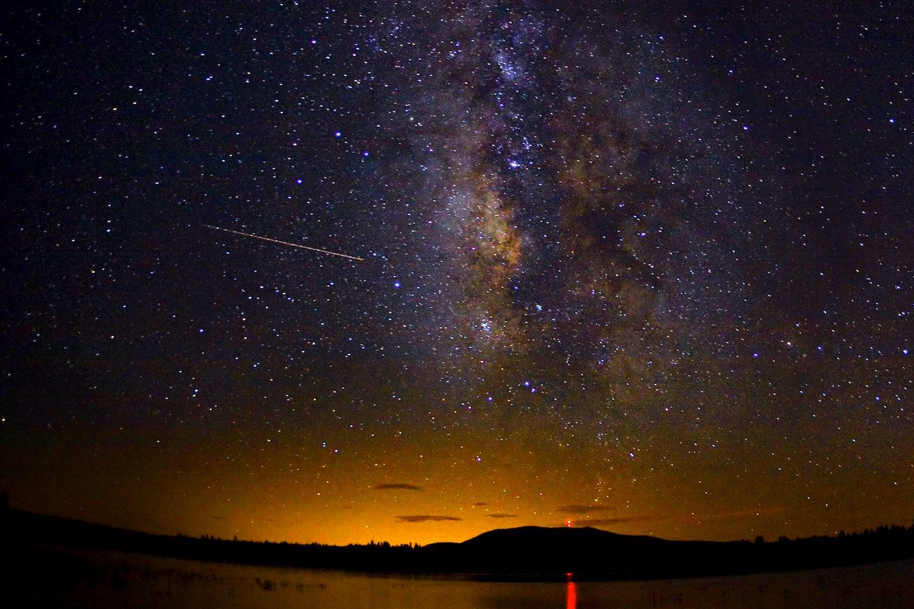
Archeoastronomy: A Trip Through Time
Karthik Yadavalli

Slide 2
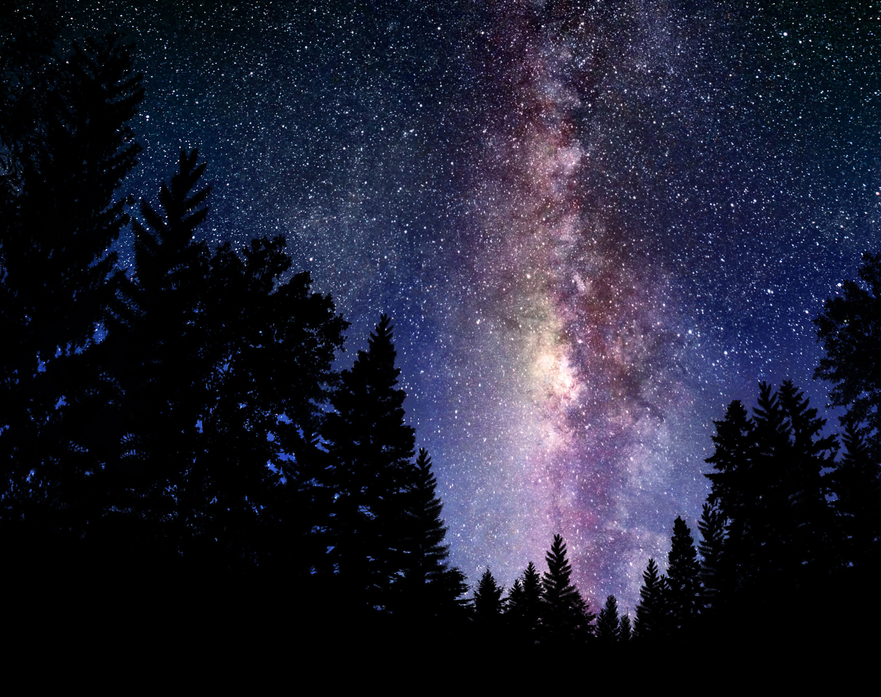
Ancient Astronomy
This is the oldest science!
We’ve been doing this since before civilization even started!

Slide 3
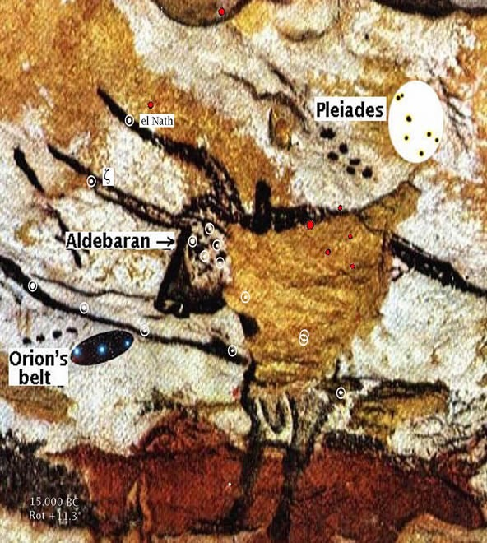
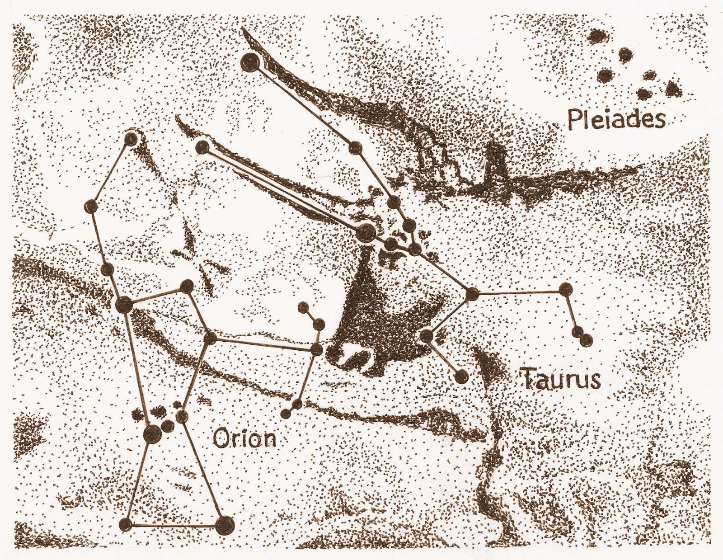
Ancient Astronomy
Lascaux Cave, France

Slide 4
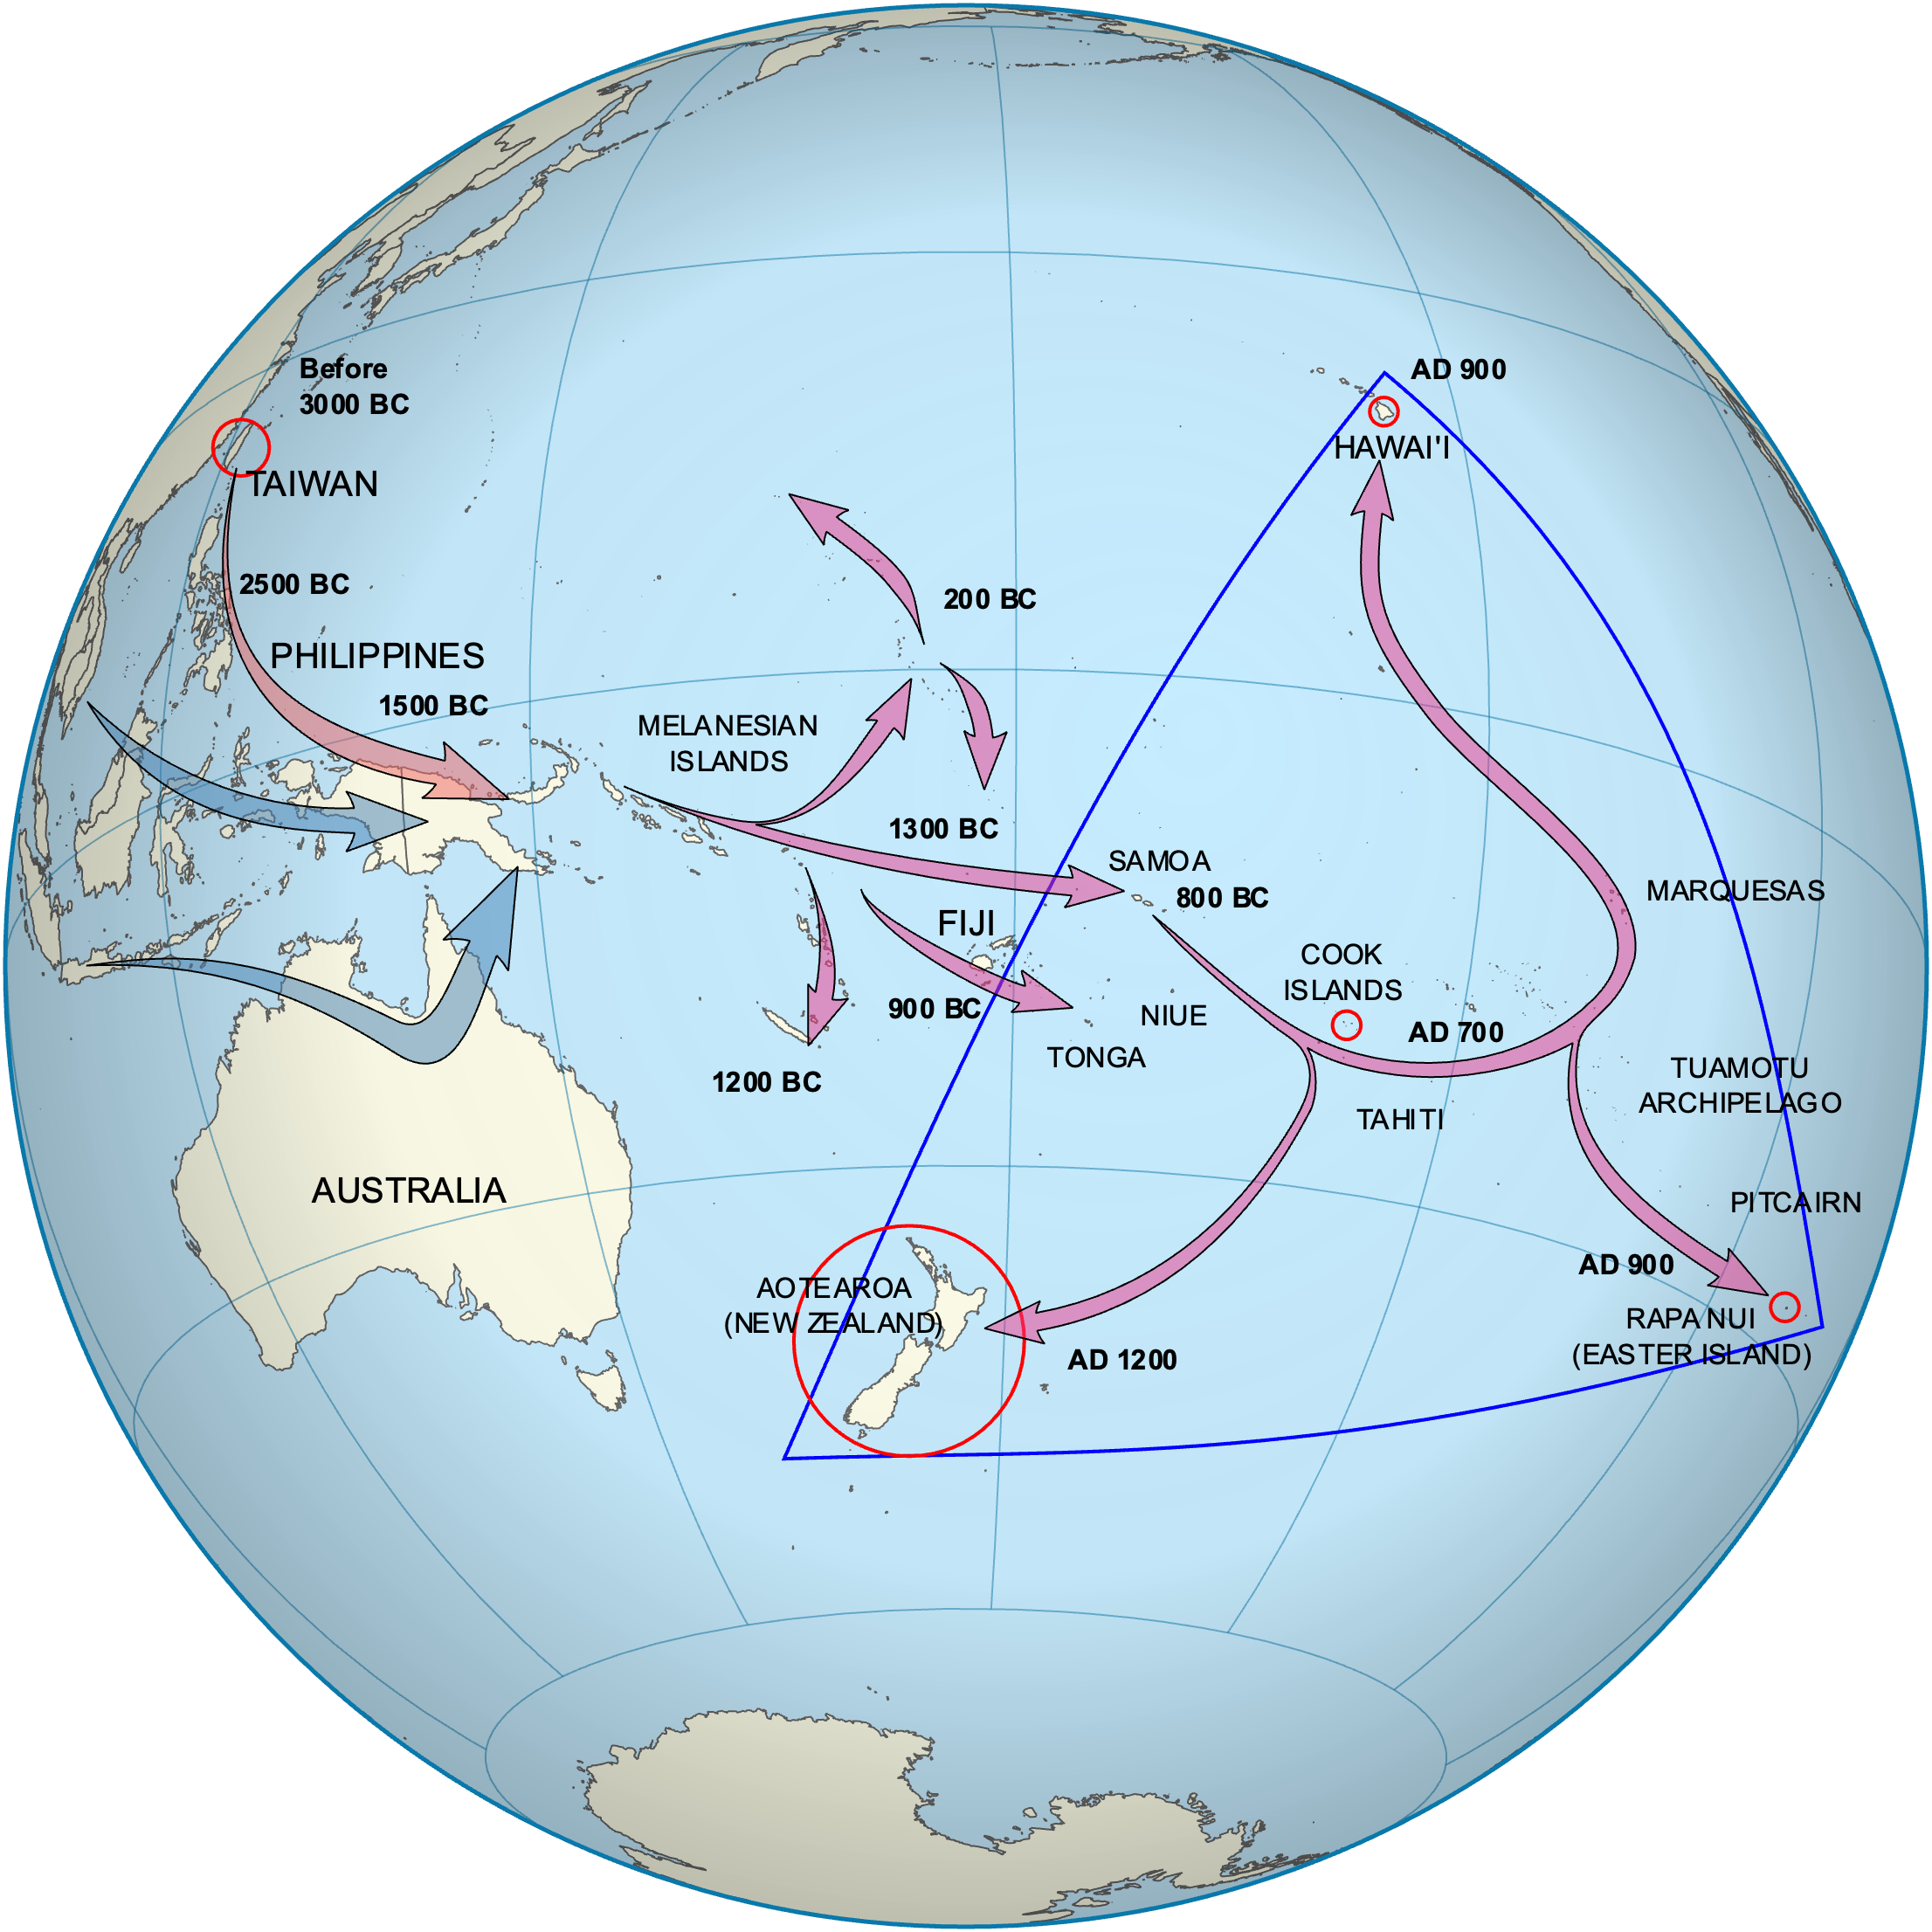
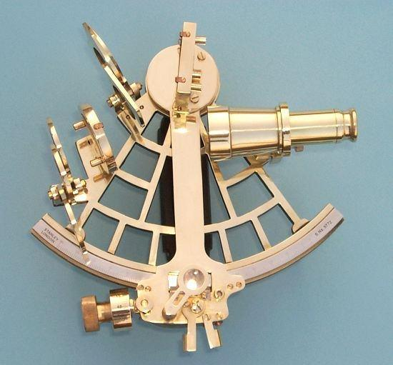
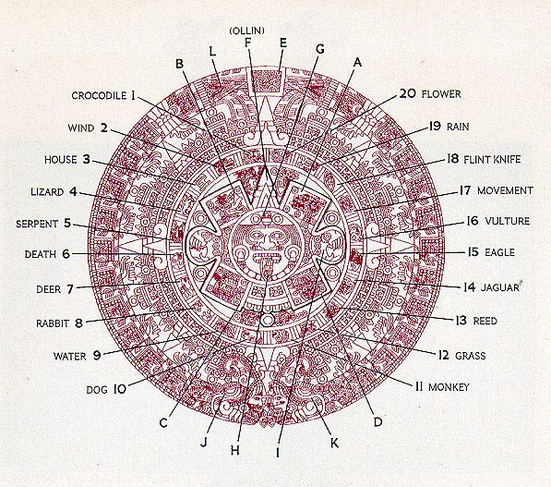
Astronomy in the Ancient World
Telling Time
Time of day > Until quite recently
Time of the year
Navigating the Sea
Sextant
Polynesian Celestial Navigation

Slide 5
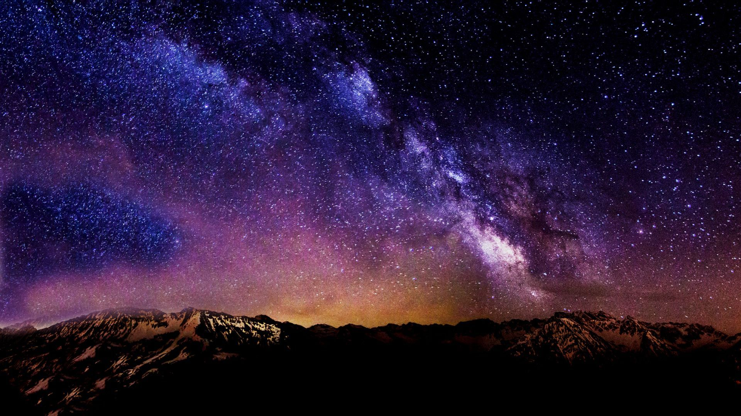

Slide 6
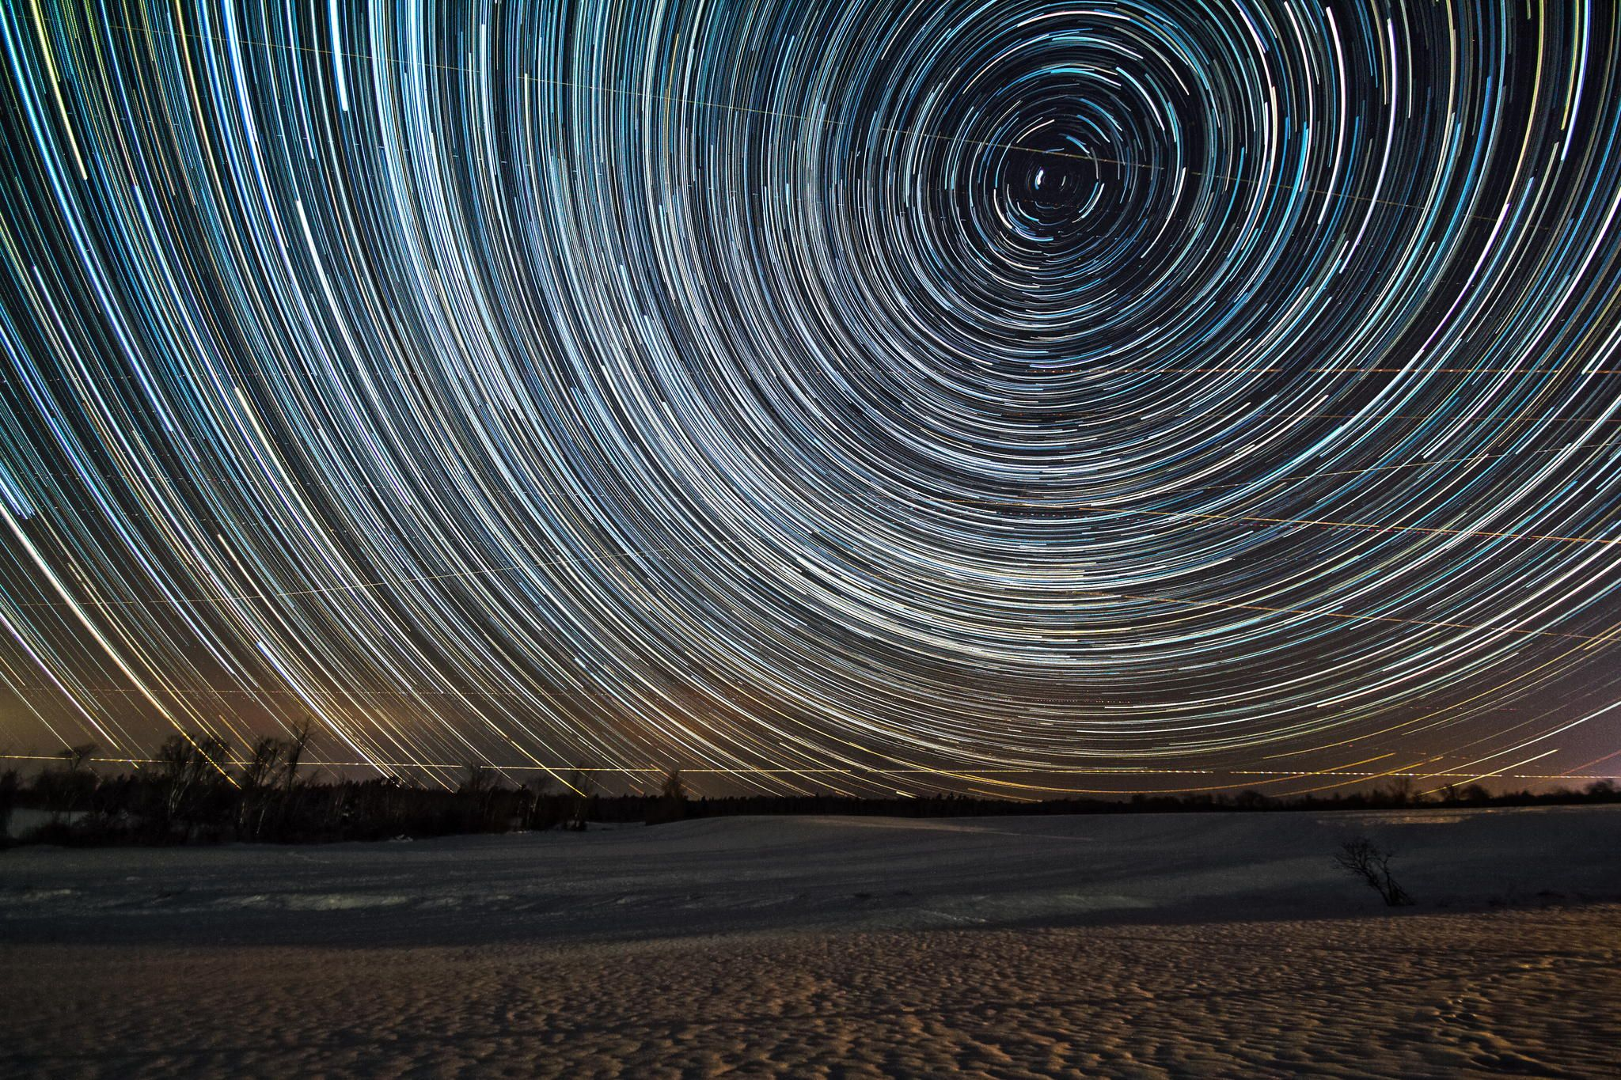
Most Dots Take the Same Path Over the Night Sky

Slide 7
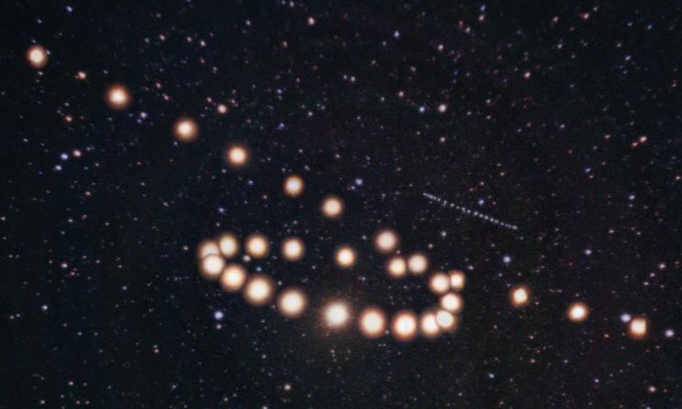
A Few Do This Instead
The retrograde motions of Mars and Uranus in 2003 (Tunc Tezel, apod031216)

Slide 8
A Few Do This Instead
Moon
Mars
Mercury
Jupiter
Venus
Saturn
Sun
The retrograde motions of Mars and Uranus in 2003 (Tunc Tezel, apod031216)

Slide 9
Stars versus Planets
Stars are predictable
Betelgeuse
Sirius
Planets wander
Wandering star = ‘Planet’

Slide 10
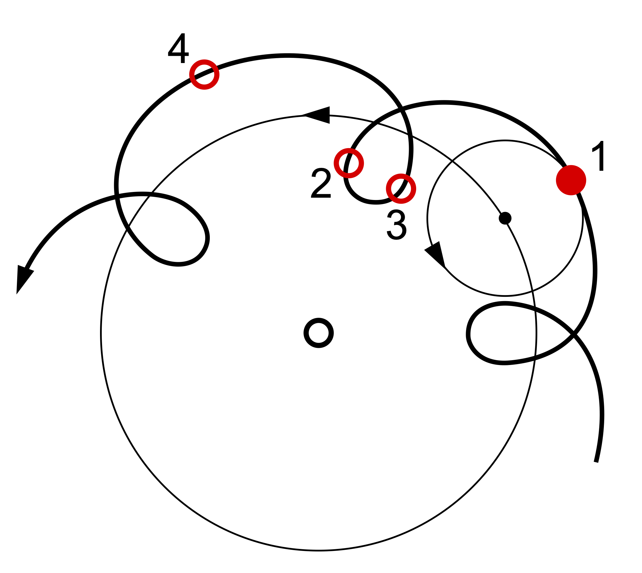
Epicycles Can Model This

Slide 11
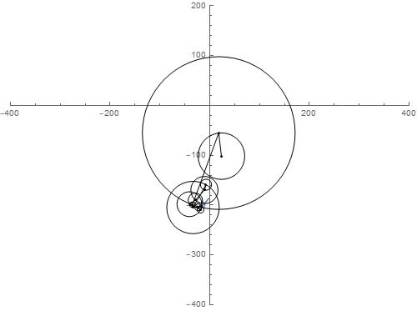
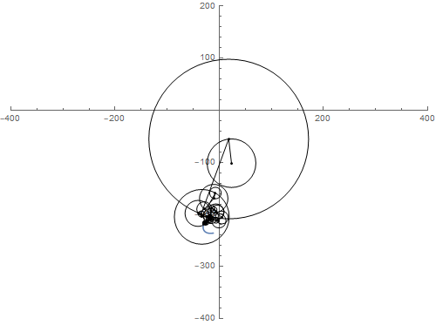
But Epicycles Can Model Anything

Slide 12
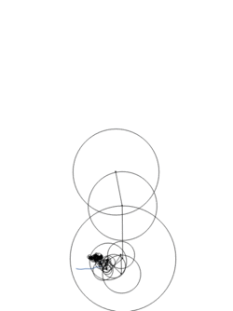

But Epicycles Can Model Anything

Slide 13
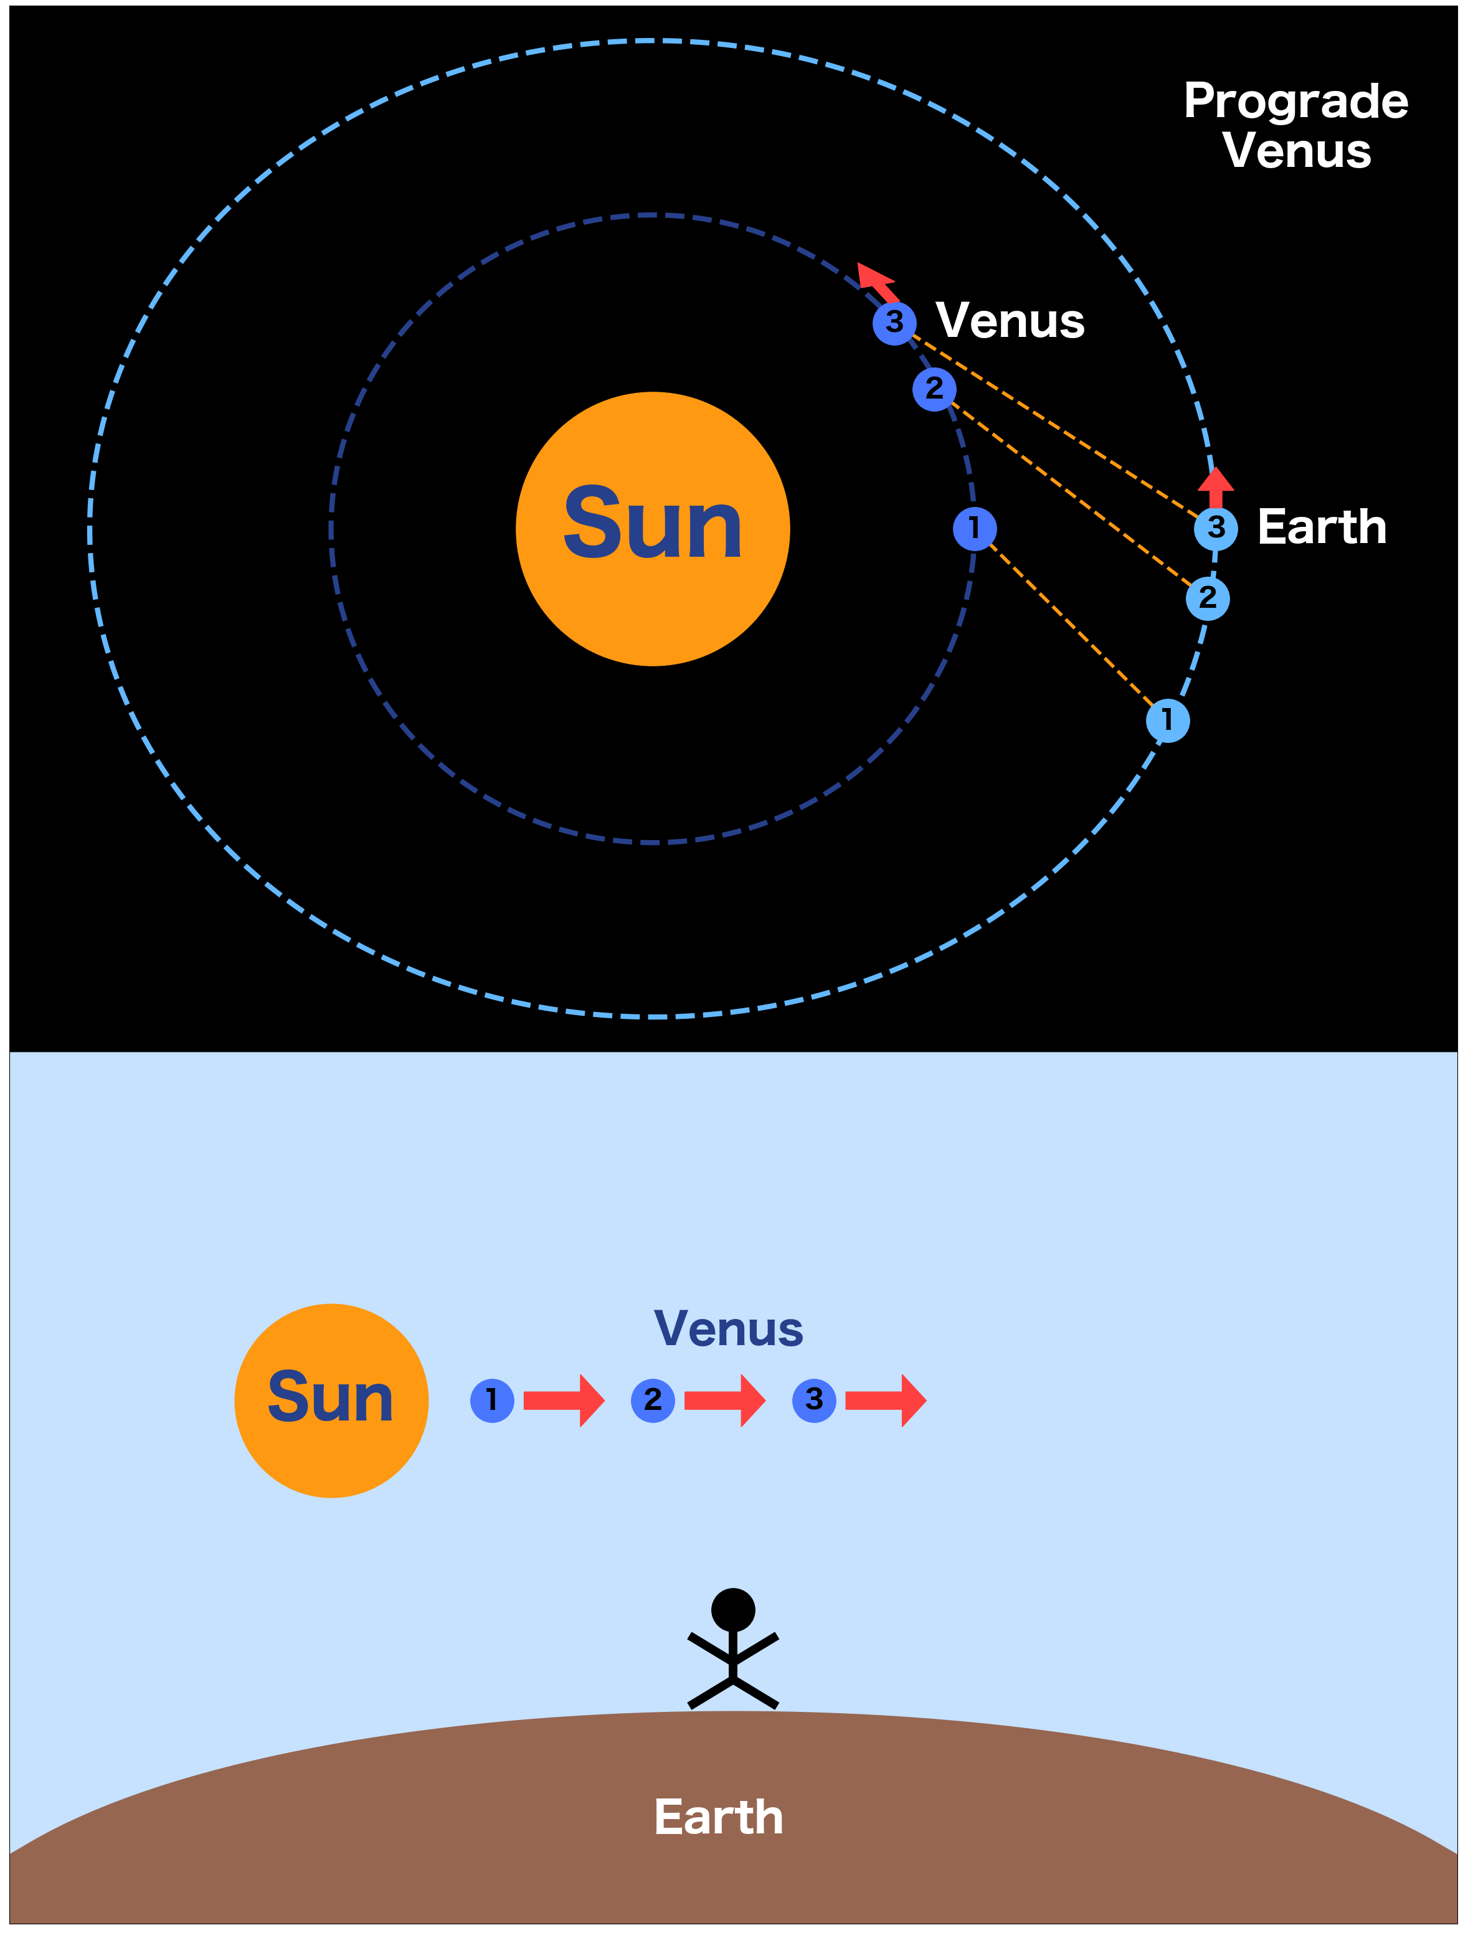
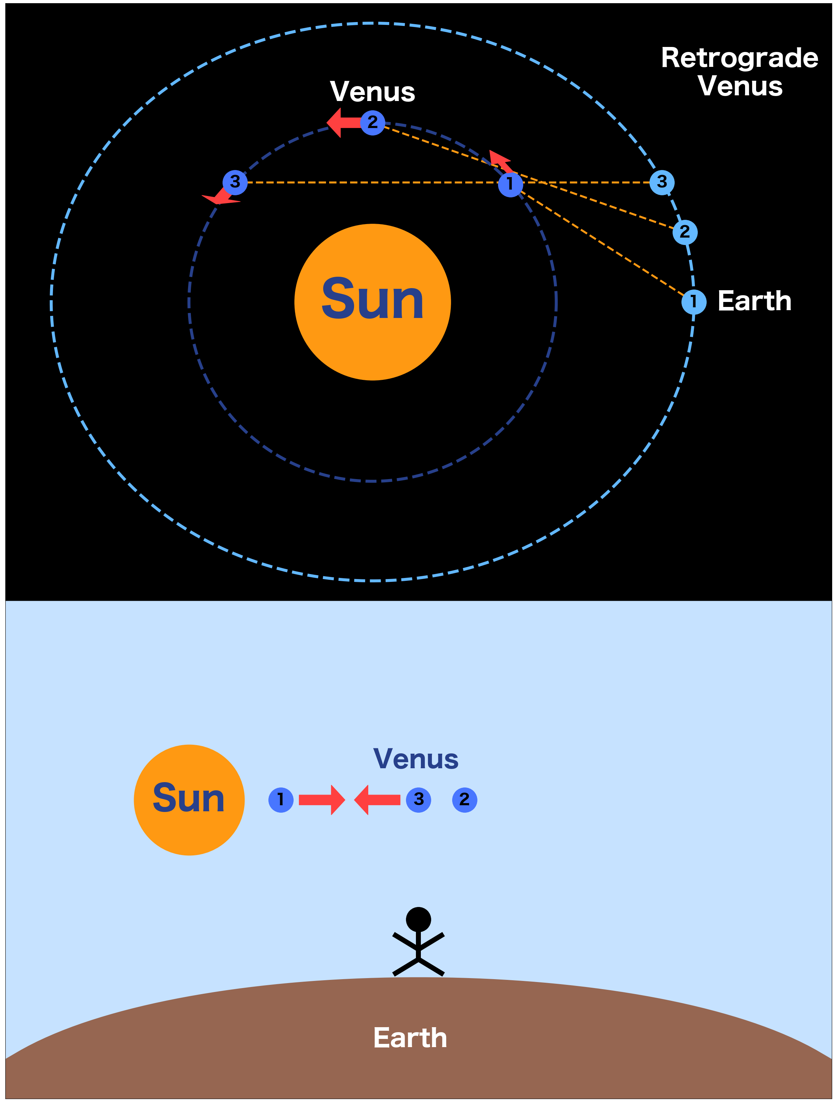
Planets Go Around the Sun!

Slide 14
Planets Go Around the Sun!

Slide 15
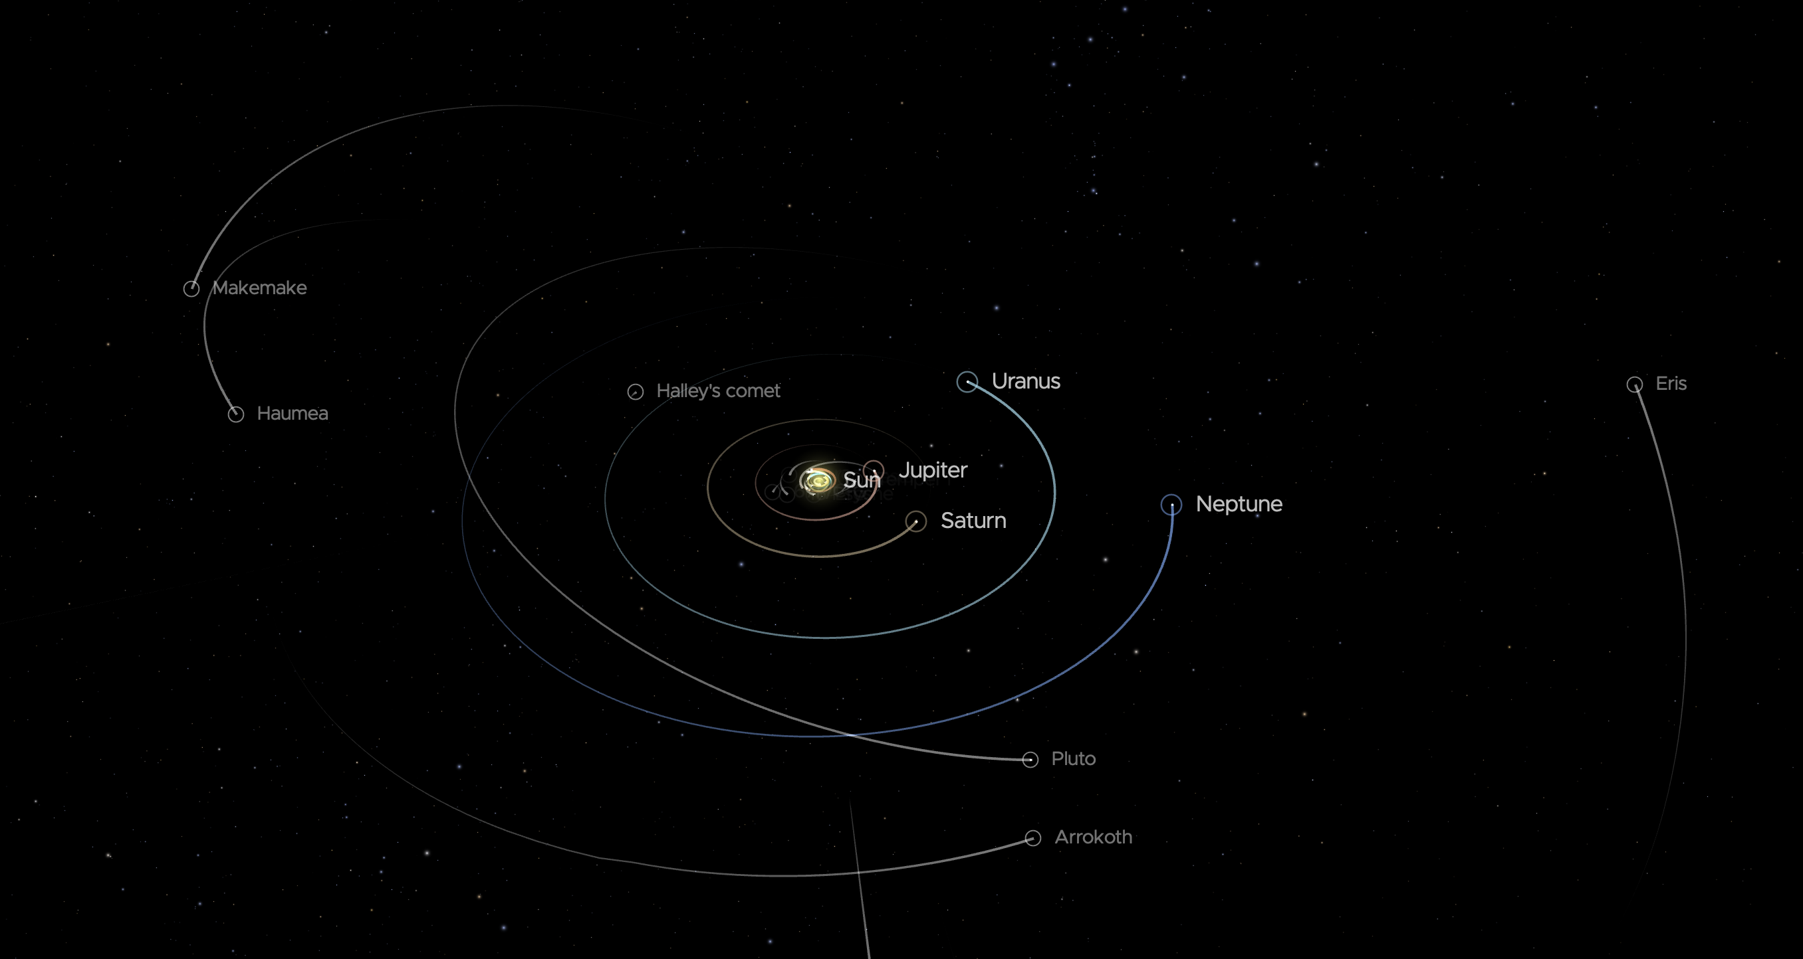
The Entire Solar System Orbits The Sun
https://solarsystem.nasa.gov/

Slide 16
Ancient Ideas

Slide 17
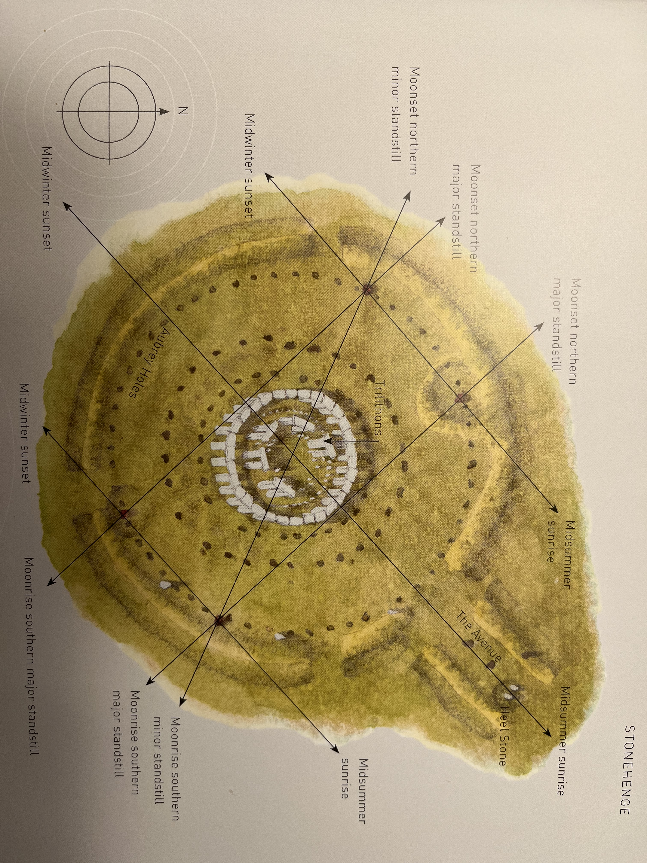
Stonehenge Is Very Precisely Aligned to the Sun’s Path Through the Year

Slide 18
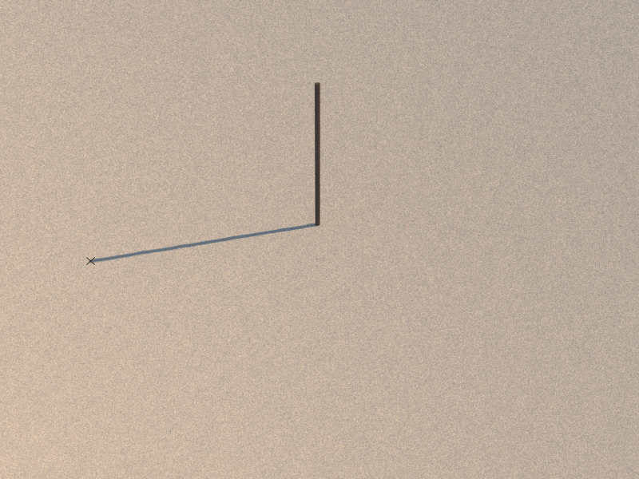
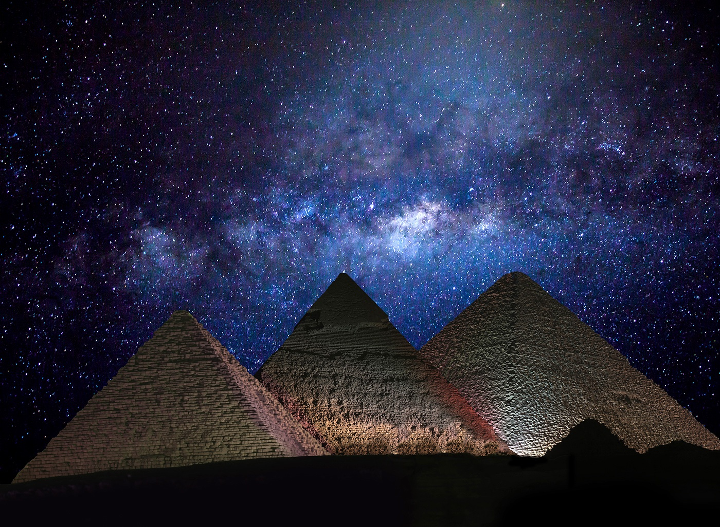
Egypt
365-day calendar
Precession of the equinoxes
‘A new constellation appears on the horizon each 2,160 year’
N/S axis of the pyramids are within 3’ of the true value

Slide 19
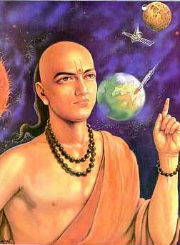
India
Base-10 counting system
Elliptical orbits around the sun
’ perhaps that there should be a force which might be keeping bodies stuck to the Earth, and also keeping heavenly bodies in their determined places’
Sun, moon: 108
Aryabhatta, ~500 AD

Slide 20
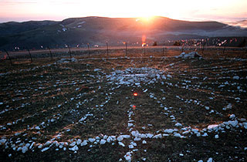
North American Medicine Wheels
Plains Native Tribes
Lakota
Dakota
Cheyenne
Bighorn Wheel Tracked Heliacal risings
When a star comes out from behind the sun!
There are hundreds of these!

Slide 21
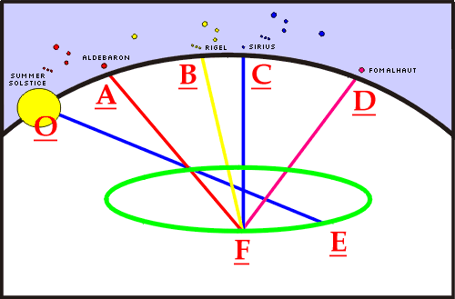
North American Medicine Wheels
Plains Native Tribes
Lakota
Dakota
Cheyenne
Bighorn Wheel Tracked Heliacal risings
When a star comes out from behind the sun!
There are hundreds of these!

Slide 22
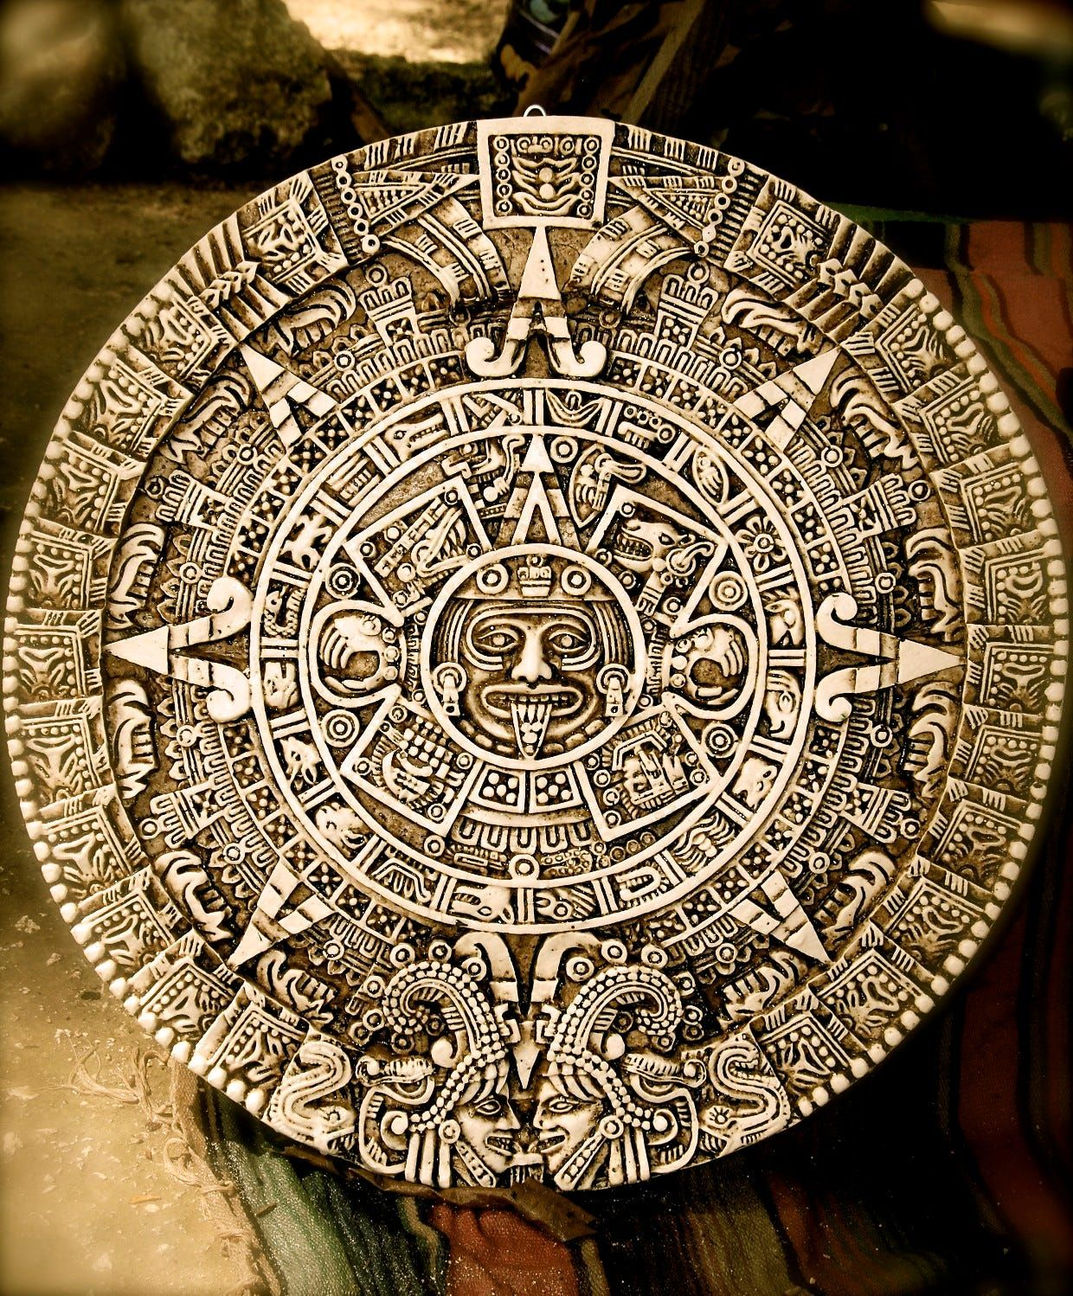
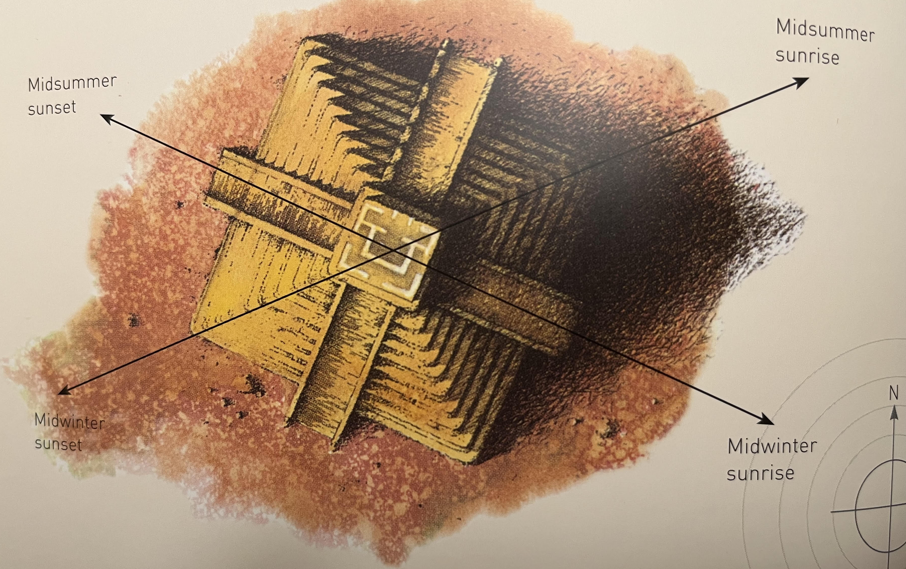
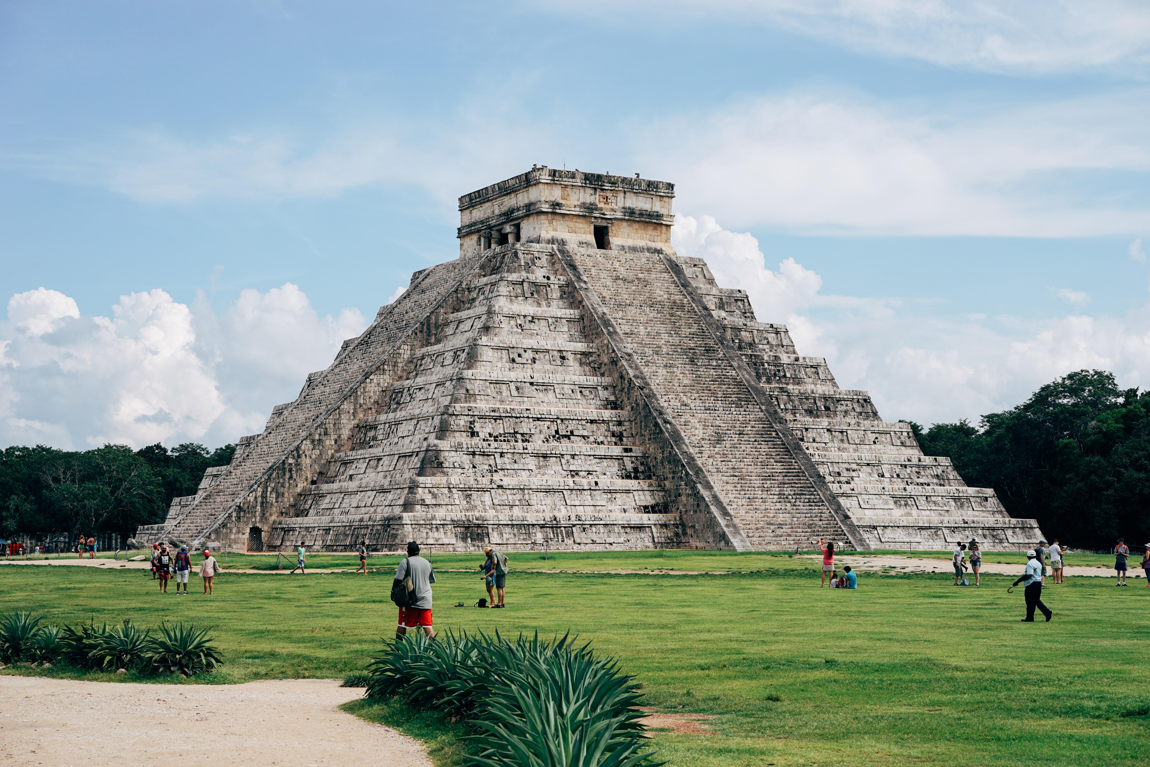
Mayan Astronomy
Chichen Itza
Four sides, 91 steps each, plus the top makes 365
Aligned with Sun

Slide 23

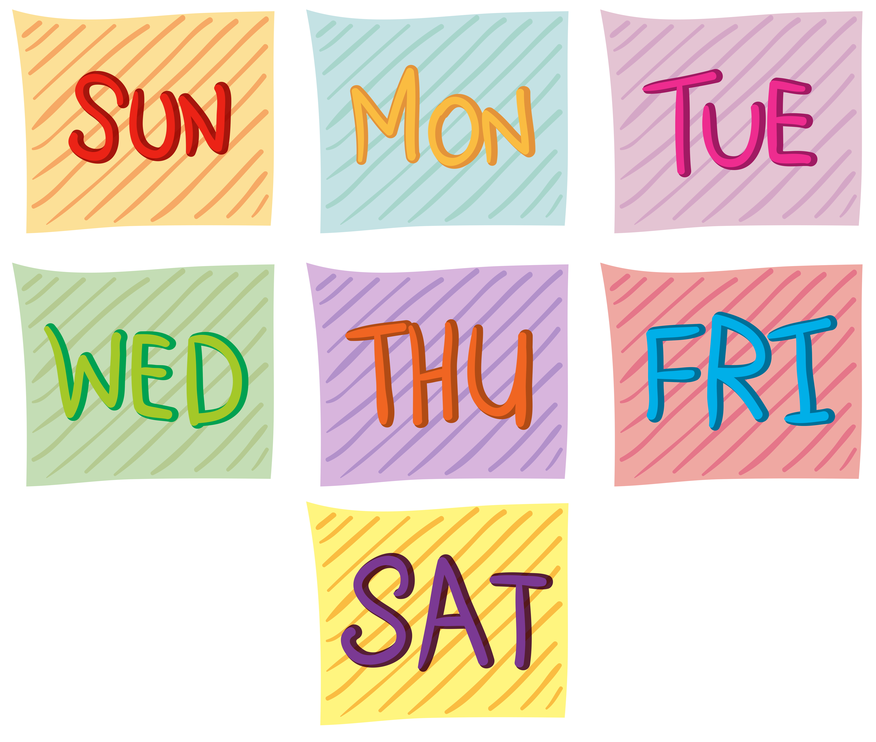

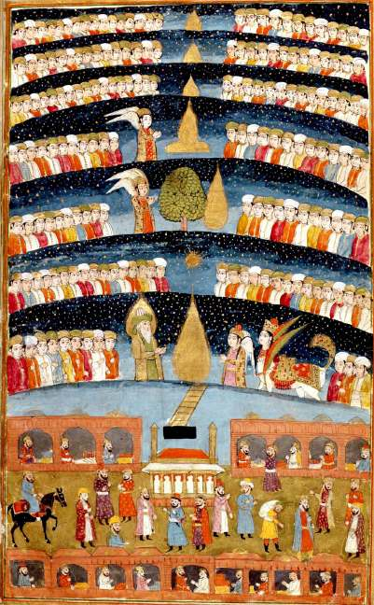
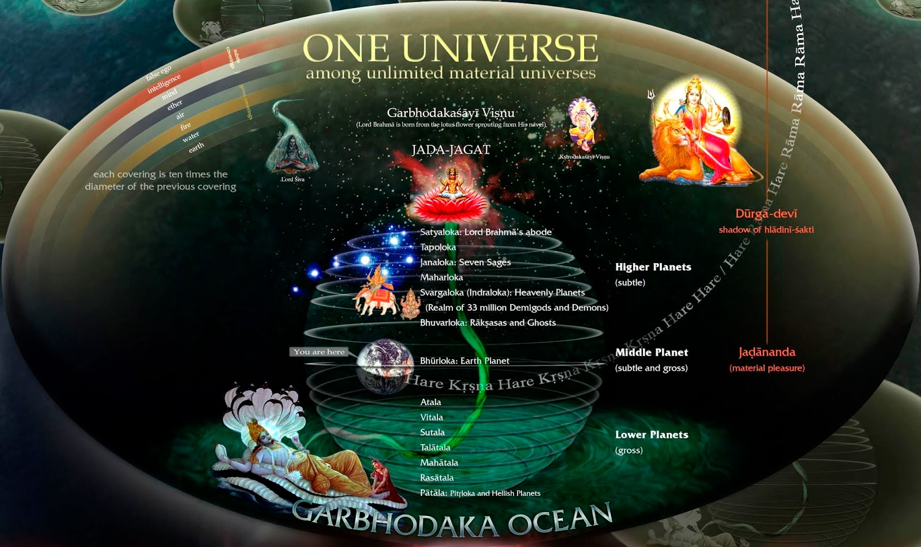

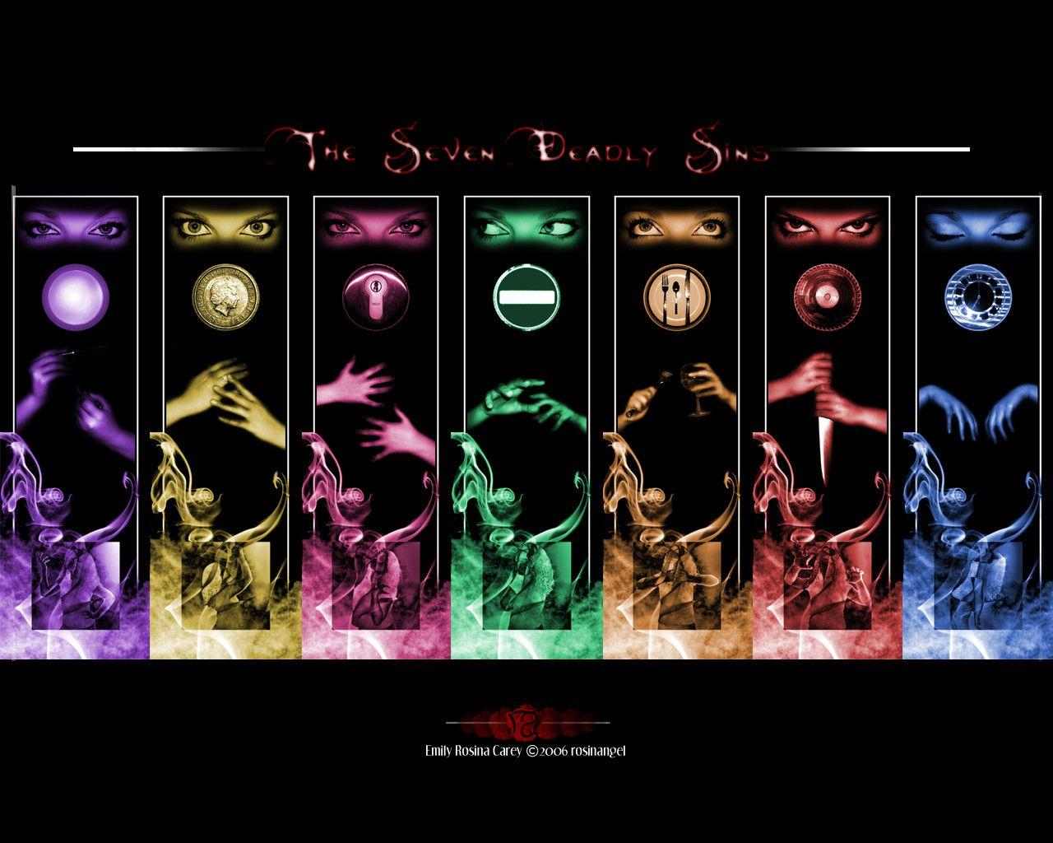
Sevens Everywhere

Slide 24
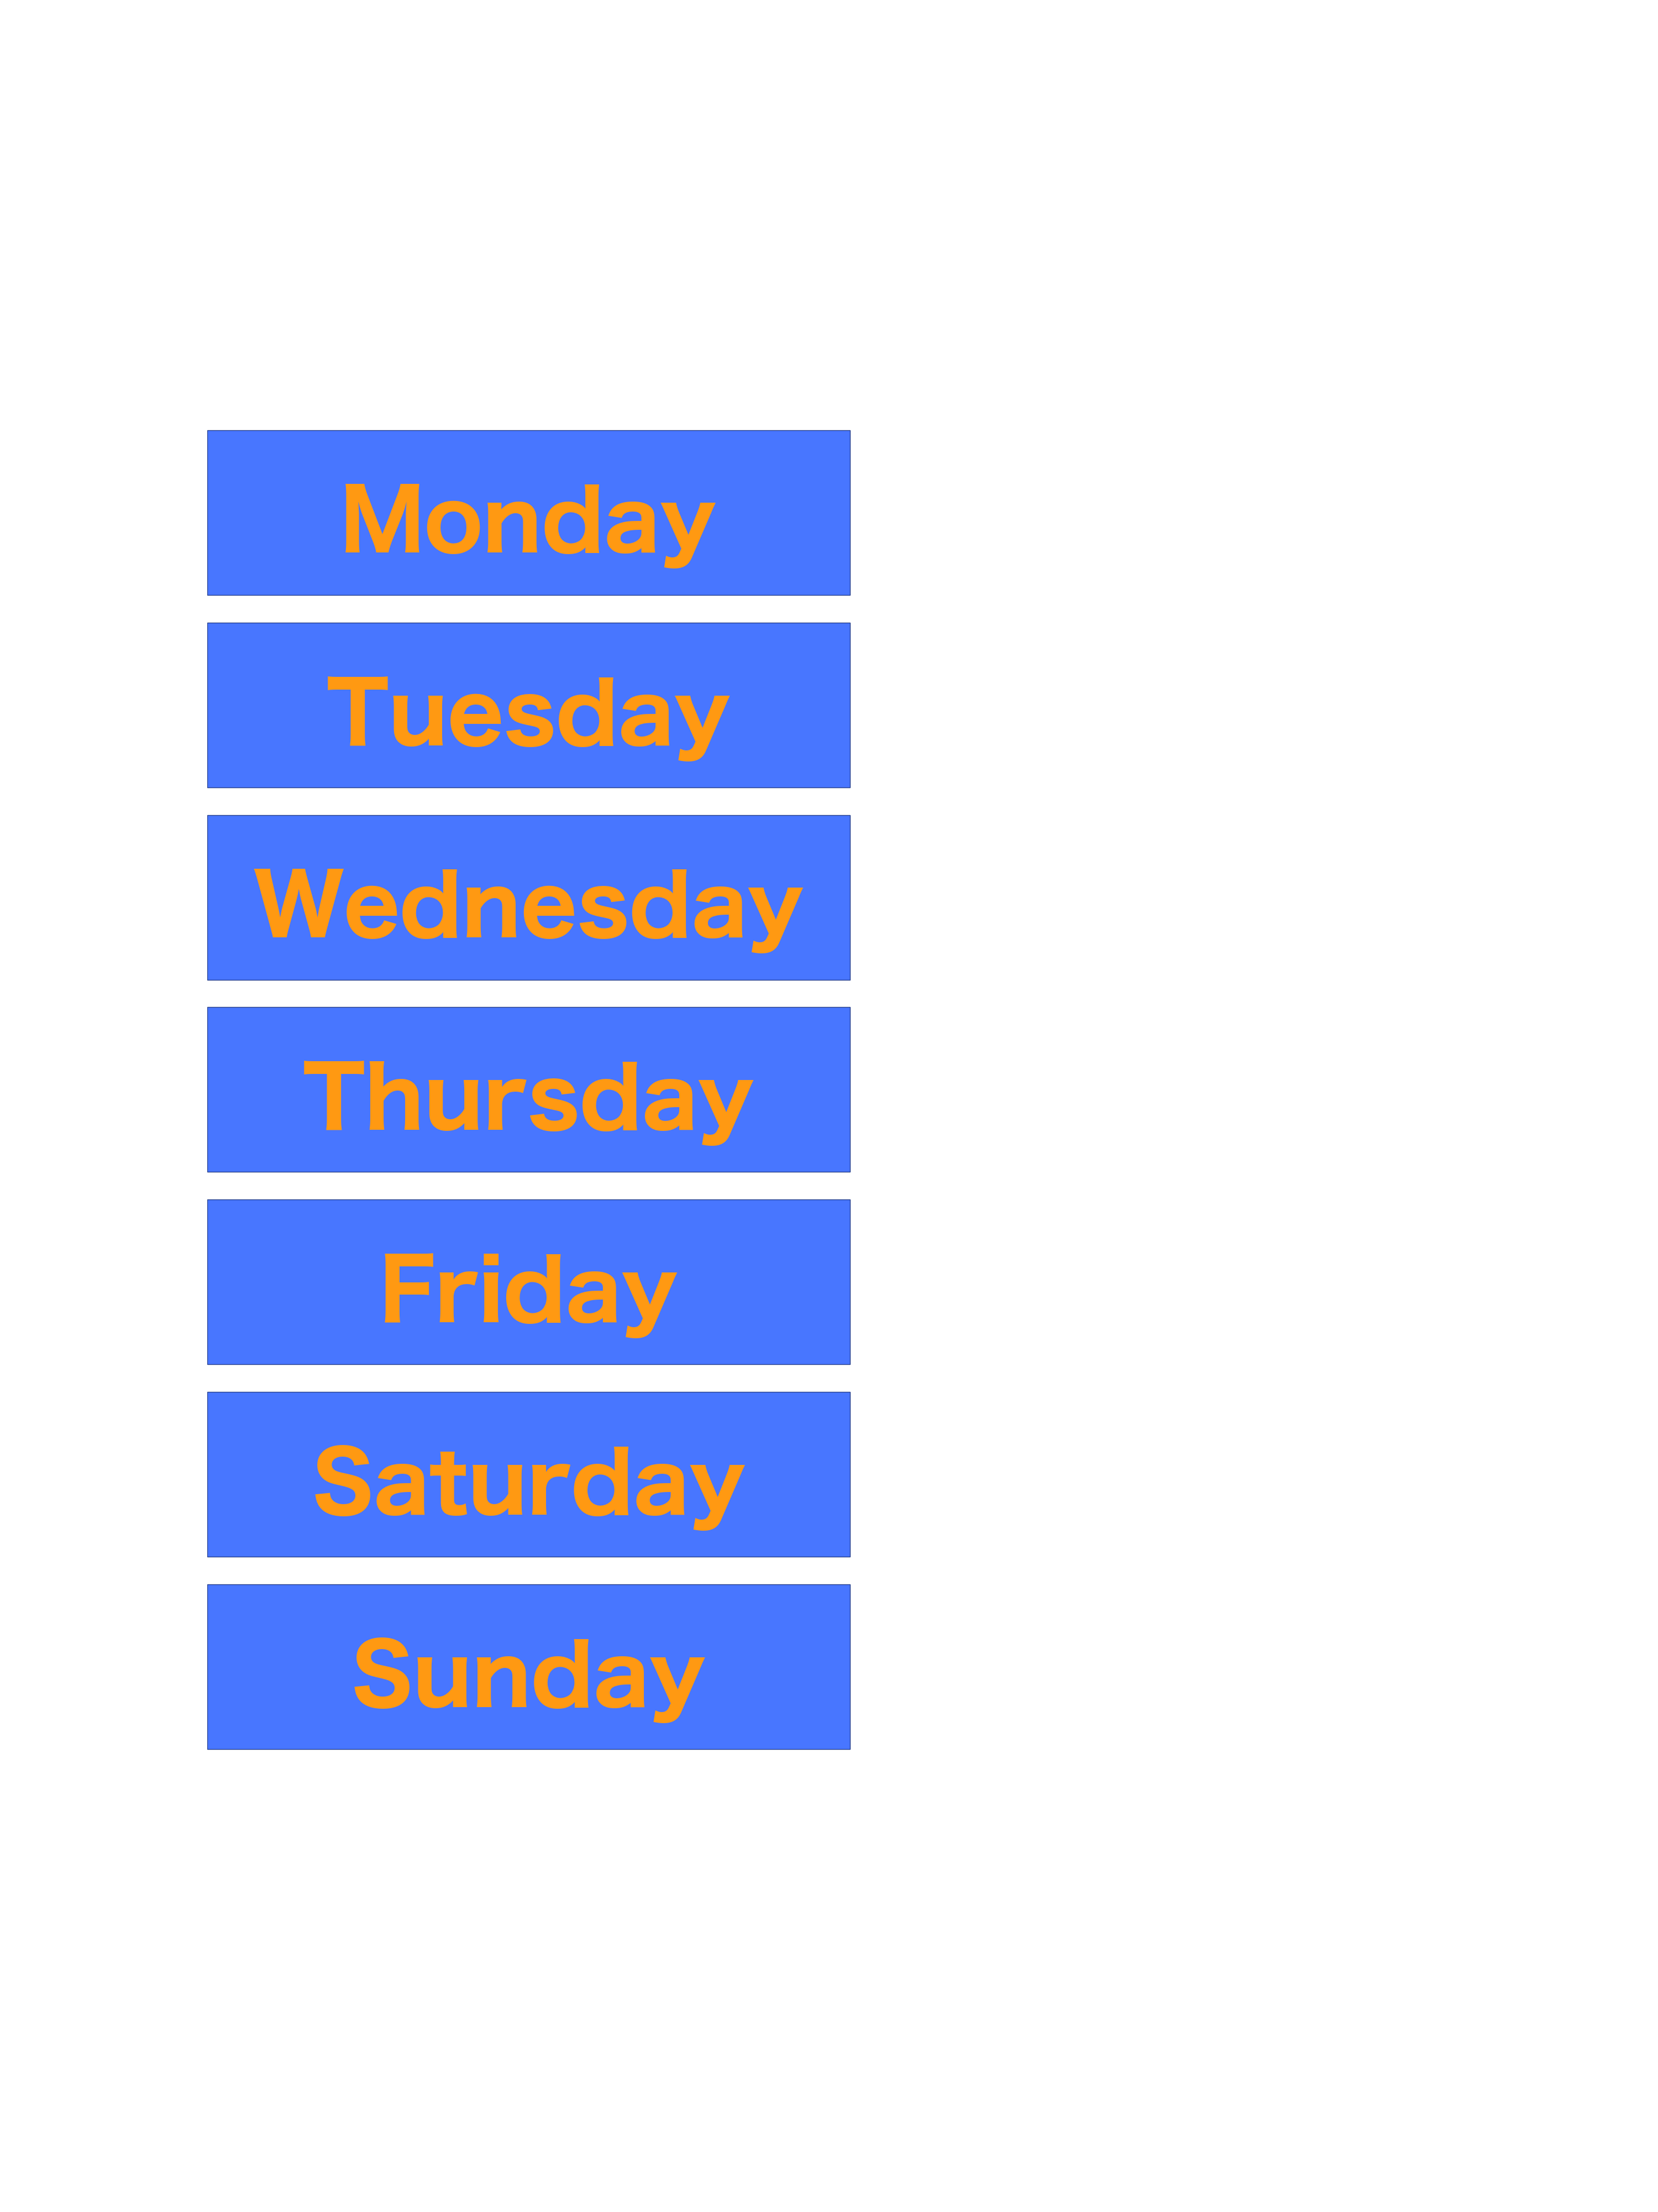
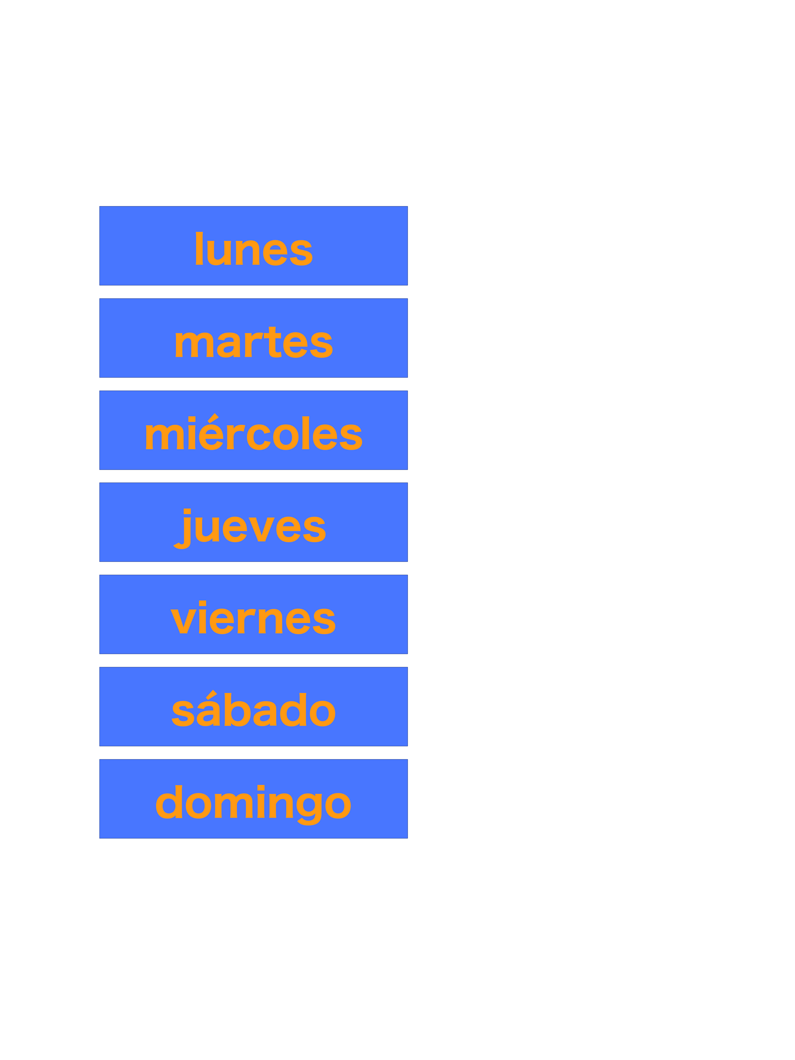

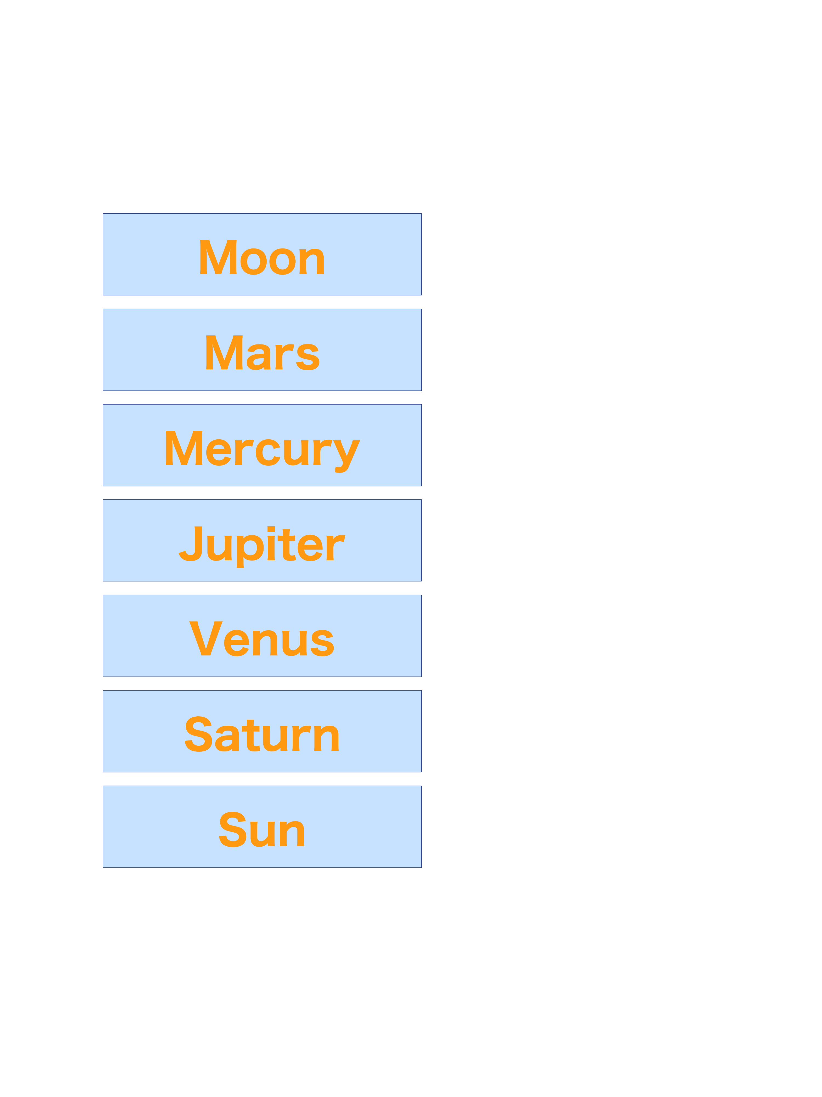
The Days of the Week Connect to the 7 Planets
Spanish
Telugu

